Slide 1
CpG Project
V. Caudill, S. Qin, R. Winstead, J. Kaur, E. Pineda

Slide 2
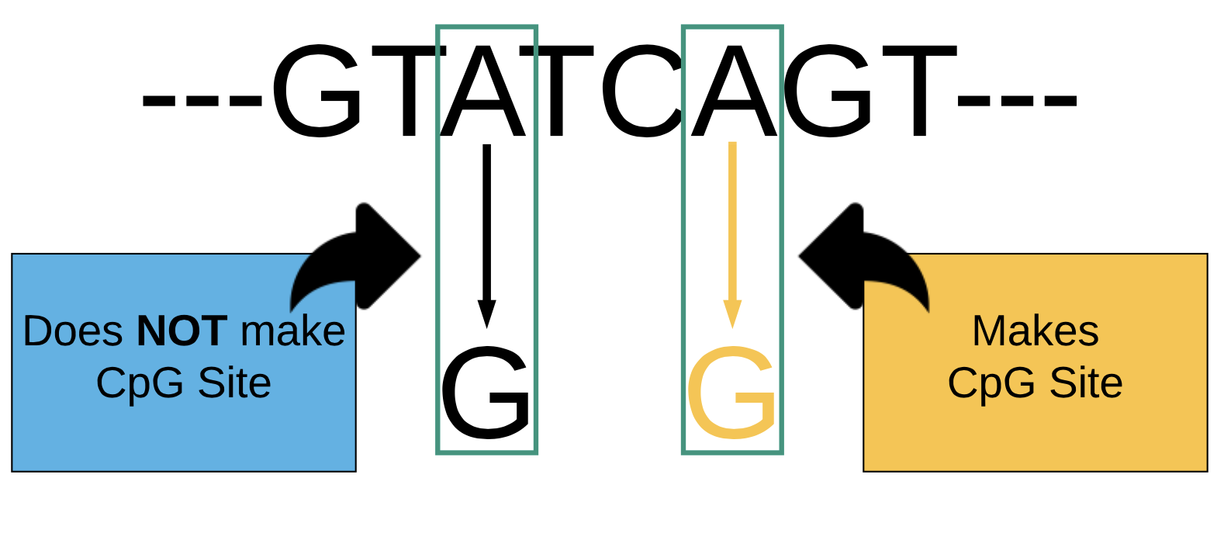
Our Question
How costly are CpG sites in viruses?

Slide 3
Data
Virus sequences from GenBank
Dengue
Influenza
Herpes
Hepatis B
Entero

Slide 4
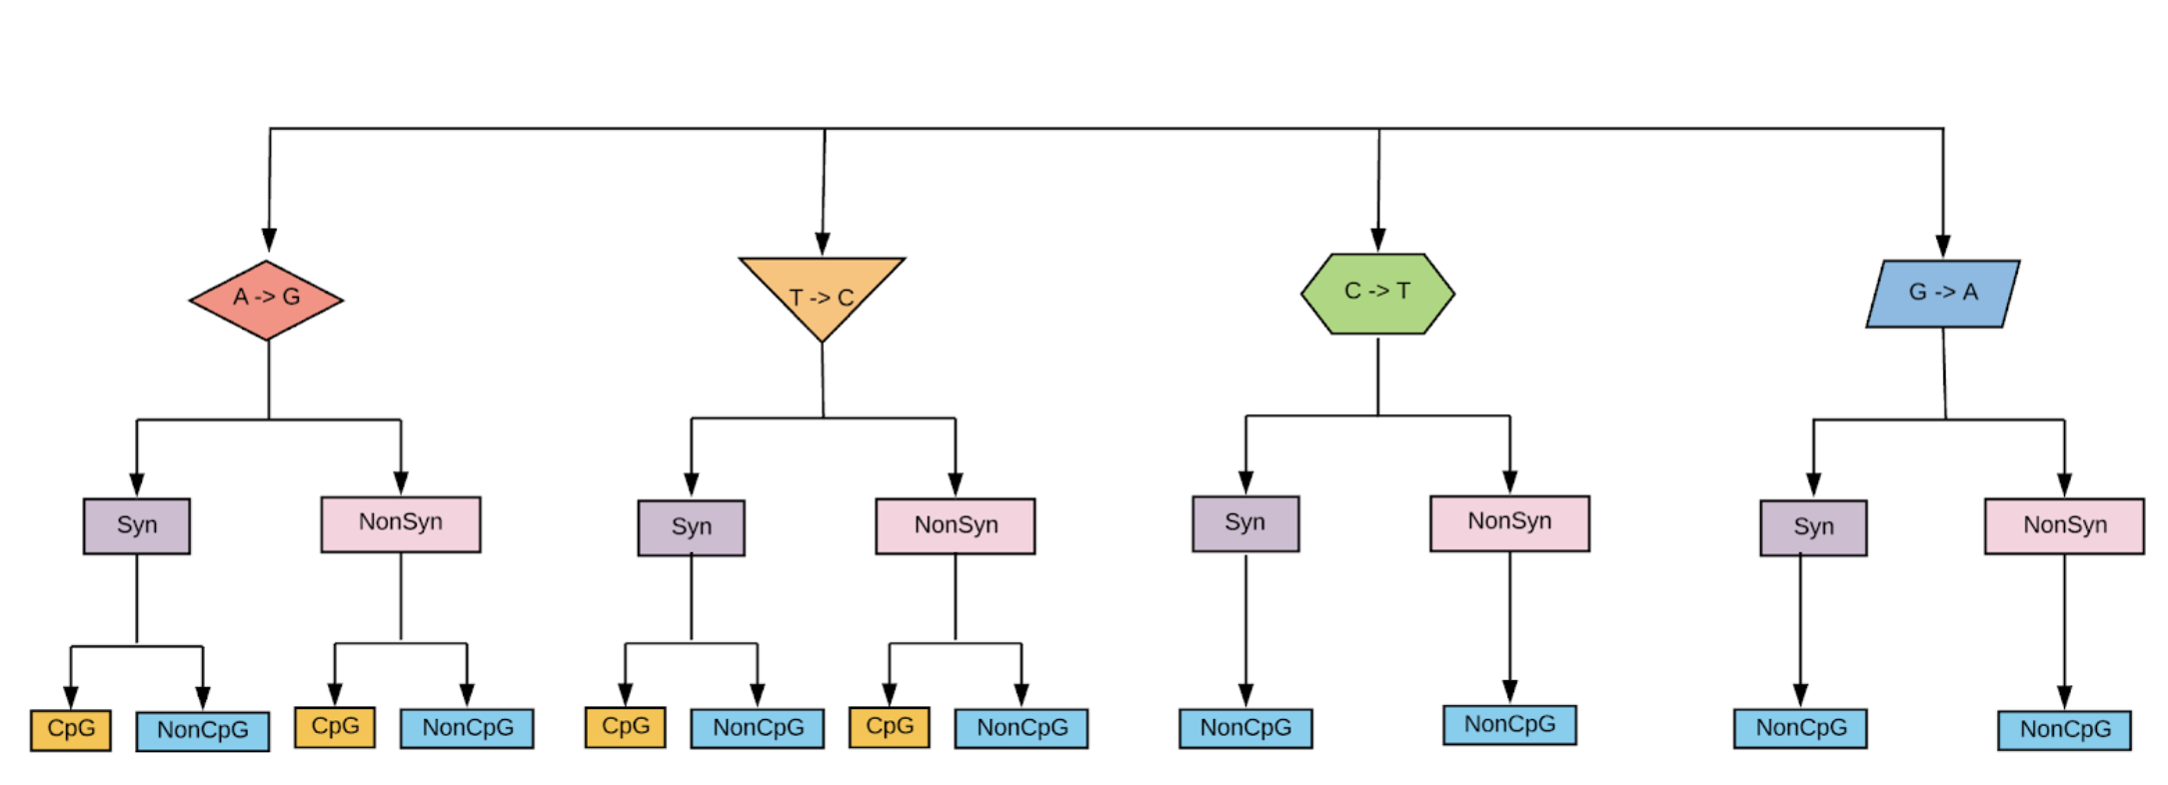
Data Analysis
Calculated and examined mutation frequency
Notes:
Comparing cpg forming mutations to non-cpg forming mutations

Slide 5
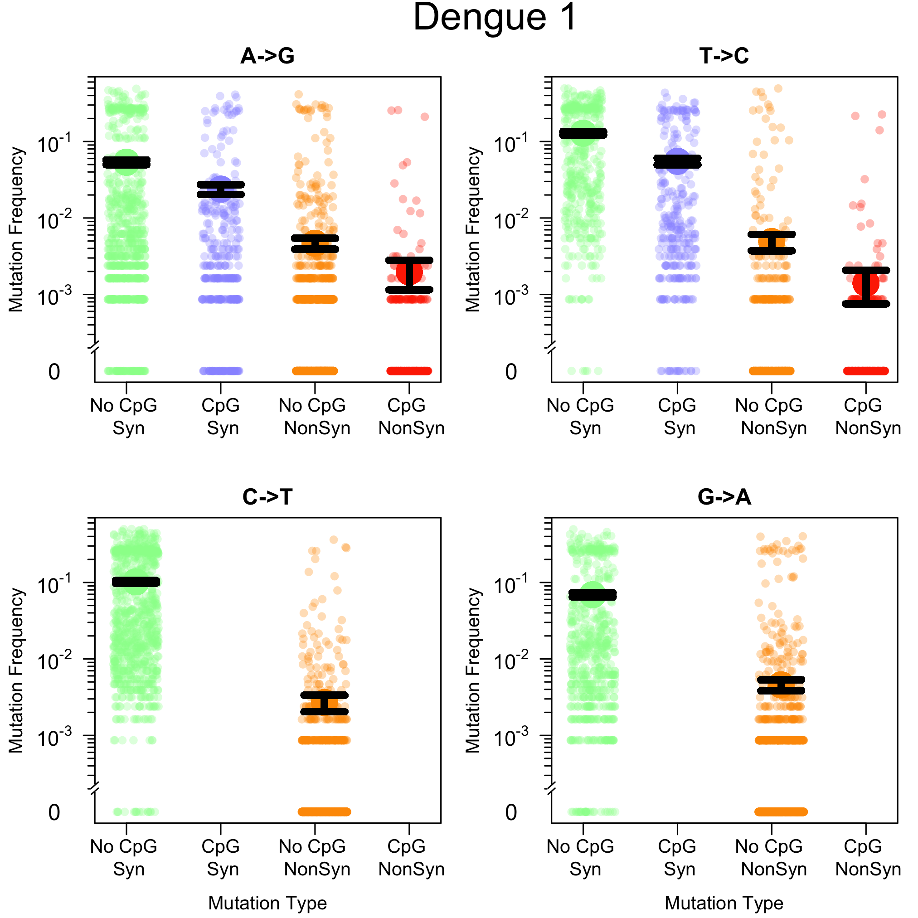
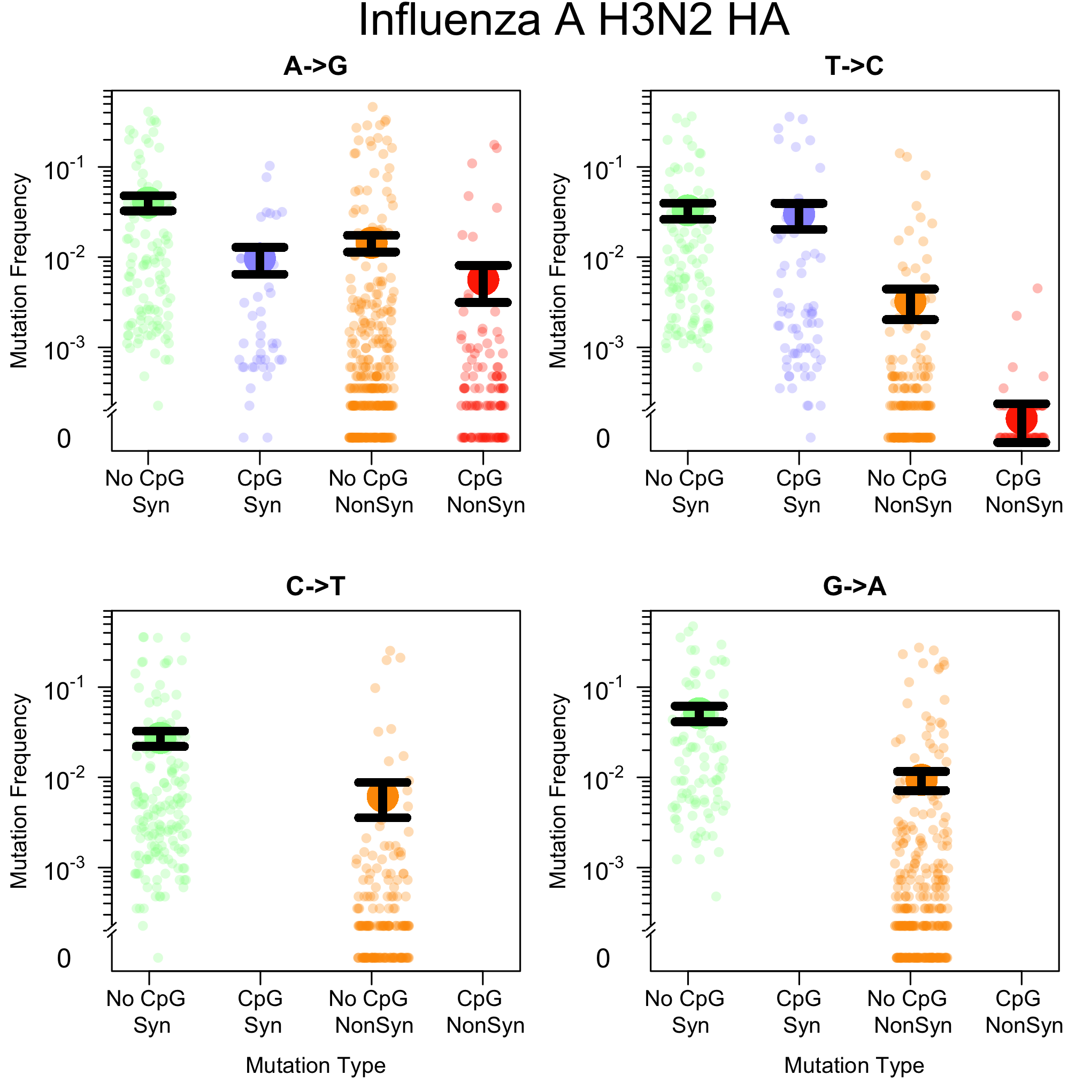

Slide 8
Expected Results
CpG creating mutations occur at lower frequencies then non-forming CpG creating mutations
But by how much?

Slide 9
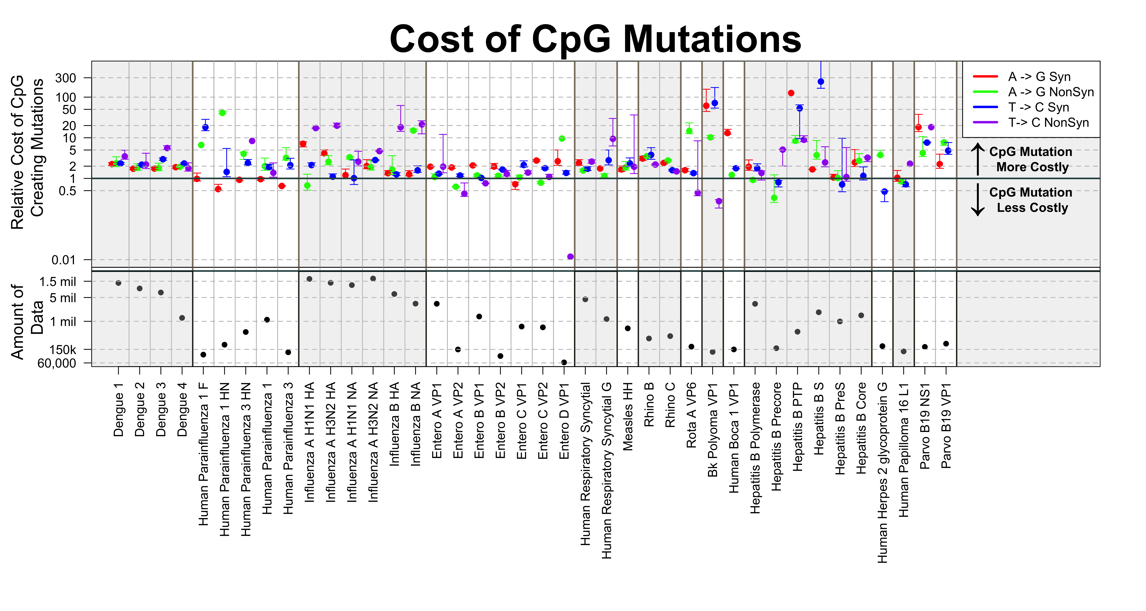
Results
For most viruses CpG sites are costly

Slide 10
Importance
Understanding how viruses and our immune system interact

Slide 11
Acknowledgements
Dr. Pleuni Pennings, SFSU
CODE Lab at SFSU

